Slide 1



Data Science
Foundations
Master in Big Data Solutions 2017-2018
Liana Napalkova
liana.napalkova@bts.tech
Ludovico Boratto
ludovico.boratto@bts.tech
Francisco Guitierres
francisco.gutierres@bts.tech
Barcelona Technology School S.L.

Slide 2
Curriculum review

Slide 3
Today’s Objective
What will we learn today?
How to perform a basic analysis of the data.
How to perform basic manipulations with the data.

Slide 4
Today’s Objective
Oct 5
Oct 9
Acquire
Store
Integrate
Pre-process
Society / Client
Oct 2
Model
Analyze
Data sources
Interpret
Visualize
Communicate

Slide 5

Contents
I. Activities in the class
II. Individual Assignment (will be explained at the end of the class)
Select an open source data in CSV format:
Load data into Pandas DataFrame
Answer a series of questions related to the data
Commit scripts to your Git

Slide 6

Contents
Python code writing
Data types
Today’s objective
Algorithmic thinking
How to perform a basic analysis of the data.
How to perform basic manipulations with the data.
File formats
Data handling with Pandas

Slide 7
Contents
Python code writing
Data types
Today’s objective
Algorithmic thinking
How to perform a basic analysis of the data.
How to perform basic manipulations with the data.
File formats
Data handling with Pandas

Slide 8
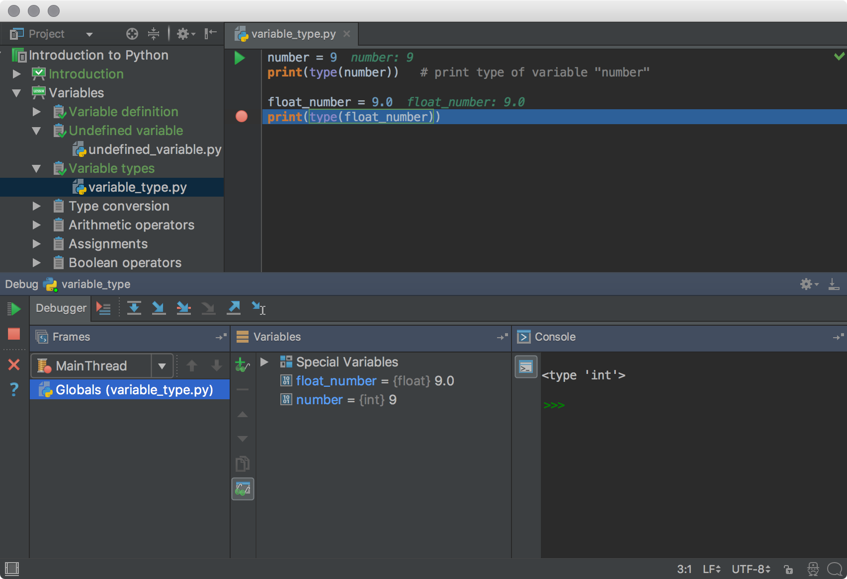
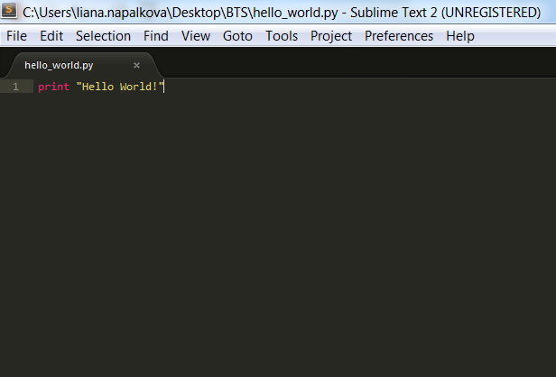
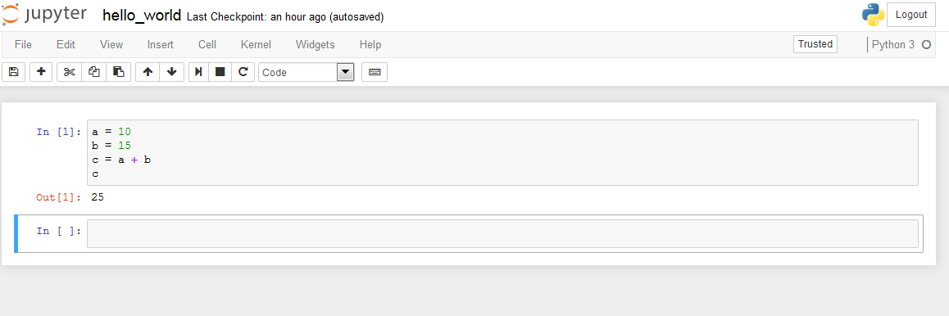
Python code writing
Where can I write my Python program?
IDE
Text Editor
REPL
Integrated Development Environment application
A simple text editor where you can type a code
Read–Eval–Print Loop, or Interactive language Shell

Slide 9
Python code writing
Integrated Development Environment (IDE) application
We can save a code in files that we can call from the command line.
Often we write those files in some Integrated Development Environment application (IDE) such as Eclipse, IntelliJ IDEA, PyCharm, etc.
IDE's often perform error checking and code suggestions as you type.
A list of Python IDEs:
https://wiki.python.org/moin/IntegratedDevelopmentEnvironments

Slide 10
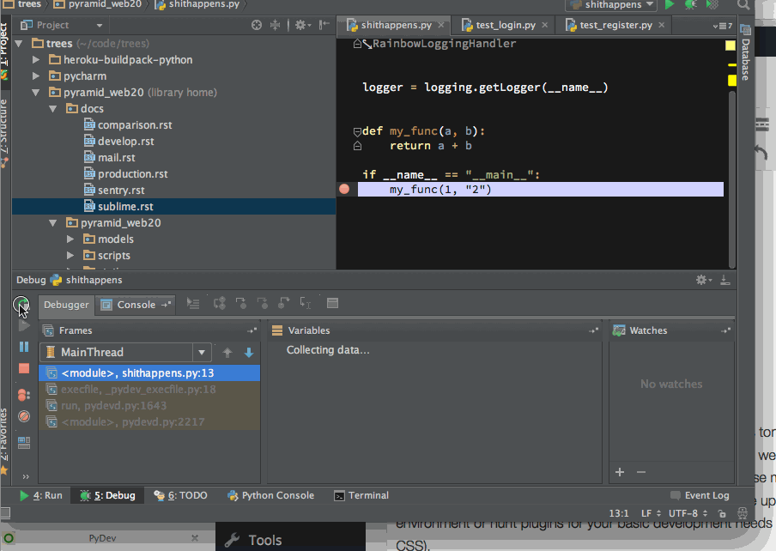

Python code writing
Integrated Development Environment (IDE) application

Slide 11
Python code writing
Text Editor
It is also possible to type the code in a text editor.
Unfortunately the built-in Mac text editor, TextEdit isn't great for the task as it doesn't like saving files in formats other than simple text formats.
On Windows, the default Notepad application is buggy, and should never be used; however, replacements such as Notepad++ and ScTE are far superior tools that highlight code in ways that makes it more readable.
A good solution that works on all platforms is Sublime Text:
http://www.sublimetext.com/2

Slide 12
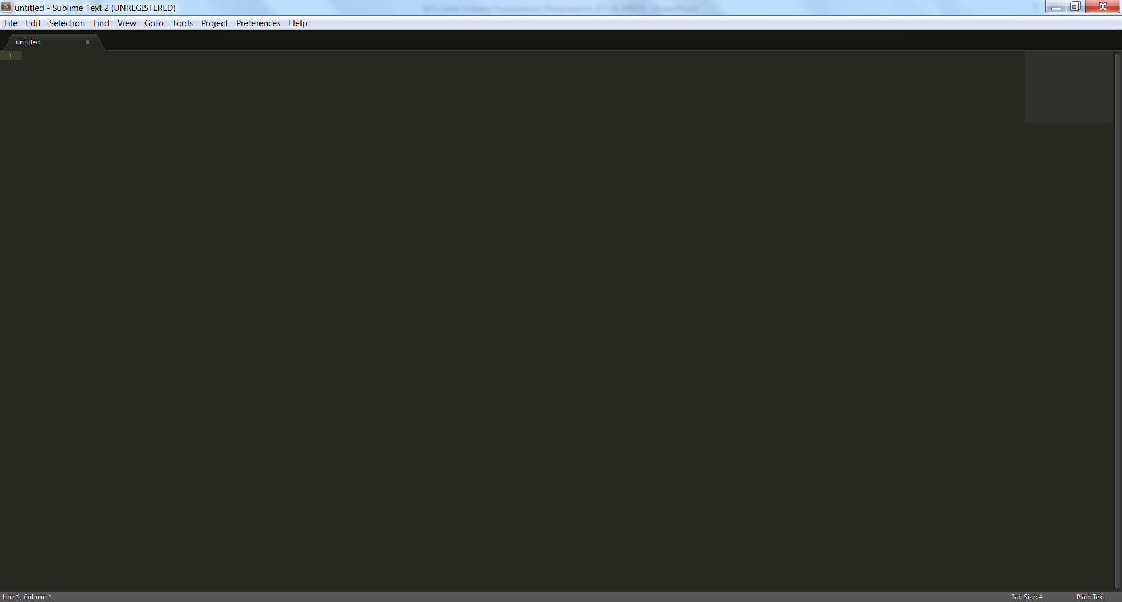
Python code writing
Text Editor

Slide 13
Python code writing
Text Editor
Open your Text Editor (for example, Sublime Text)
Write this simple Python script in your text editor:
print("Hello World")
Save it in your folder as hello_world.py.
Run your file:
Go to your command line (for example, use Anaconda Prompt),
Navigate to your folder using cd C:\path-to-your-folder\
Write the following command:
python hello_world.py

Slide 14
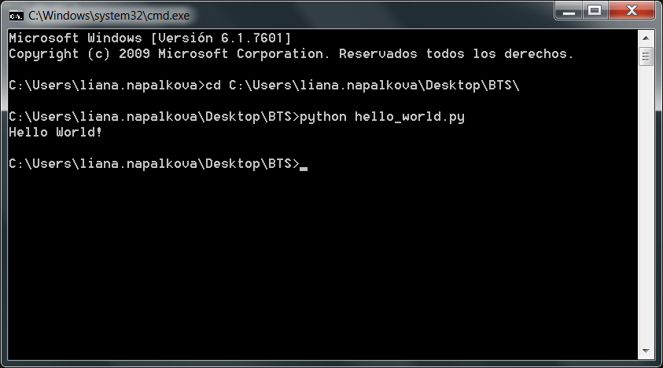
Python code writing
Text Editor

Slide 15
Python code writing
Read–Eval–Print Loop (REPL): Jupyter Notebook
Sometimes we may want to write programs interactively (for example, to explore a data set or to test some code samples).
In this case the easiest option is to work in a command line REPL (Read–Eval–Print Loop – interactive language shell) like Jupyter Notebook.

Slide 16
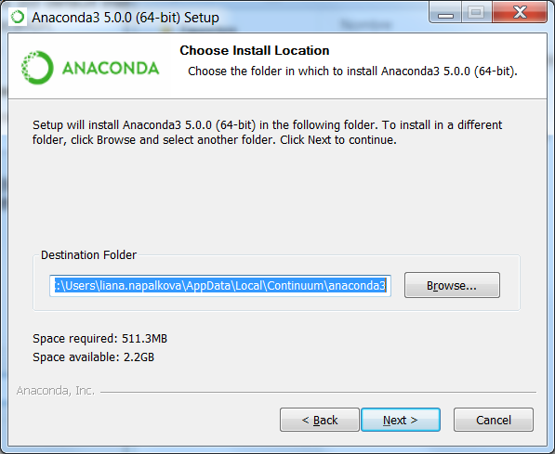
Python code writing
How to install Jupyter Notebook
https://www.anaconda.com/download/

Slide 17
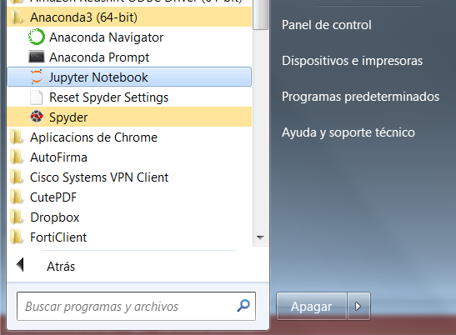
Python code writing
Read–Eval–Print Loop (REPL): Jupyter Notebook

Slide 18
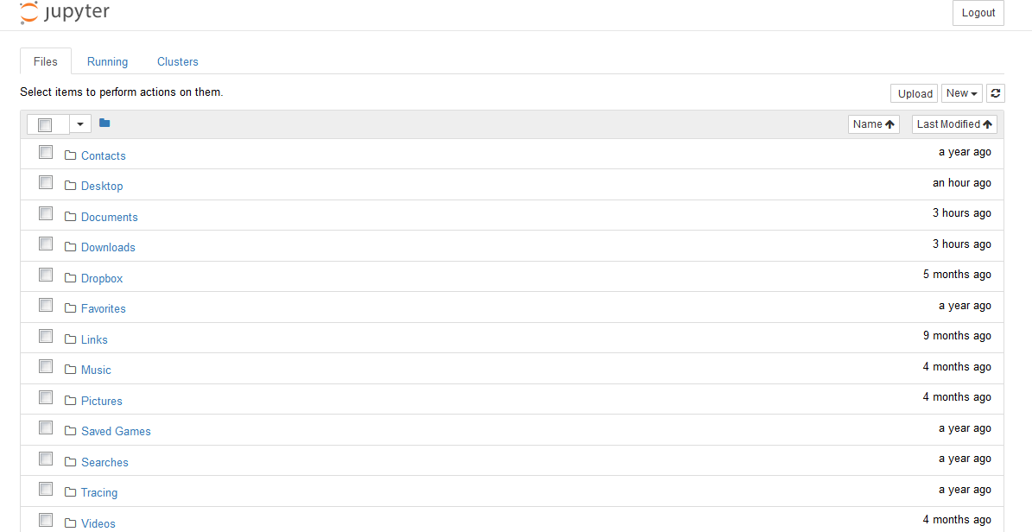
Python code writing
Read–Eval–Print Loop (REPL): Jupyter Notebook

Slide 19
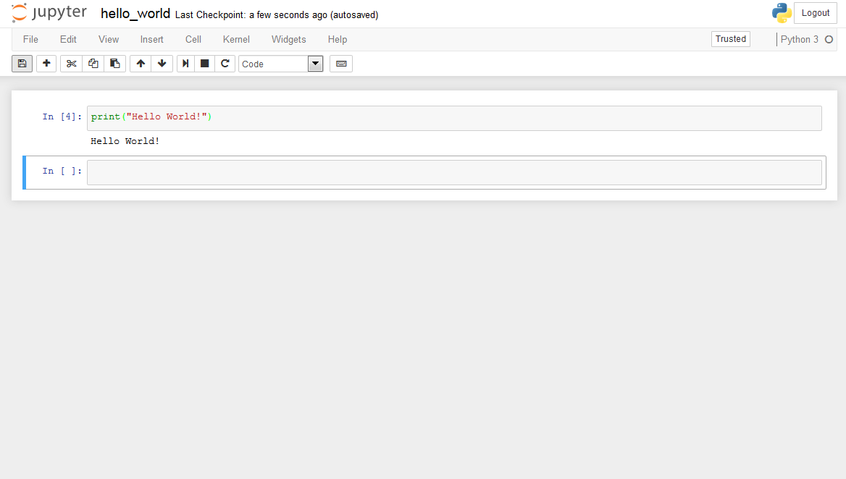
Python code writing
Read–Eval–Print Loop (REPL): Jupyter Notebook
Click to execute the code

Slide 20
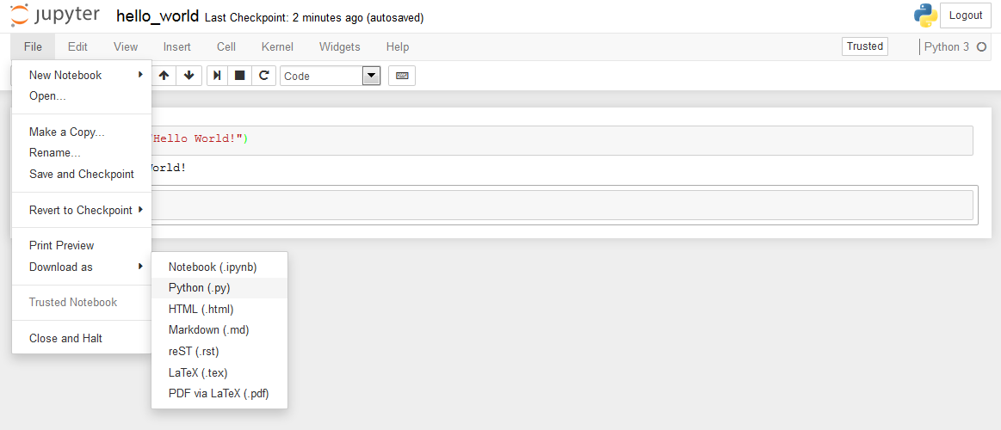
Python code writing
Read–Eval–Print Loop (REPL): Jupyter Notebook
You can download your script from Jupyter Notebook

Slide 21
Python code writing
We will mostly use Jupyter Notebook during the next 3 sessions.

Slide 22
Contents
Python code writing
Data types
Today’s objective
Algorithmic thinking
How to perform a basic analysis of the data.
How to perform basic manipulations with the data.
File formats
Data handling with Pandas

Slide 23

Data types
1
4
BOOLEANS
2
5
3
6

Slide 24
Booleans
The Boolean data type is the most simple.
A Boolean data type can only ever be True or False.
You can check this by typing the following code in Jupyter Notebook (or other tool):
t = True
type(t)

Slide 25
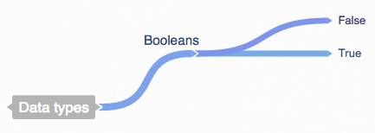
Booleans
Your current mind map

Slide 26
Booleans
Booleans are most useful in logical operations. Python offers a number of comparison operators:
== equal to
For example: 1 == 2 will evaluate to False
!= not equal to
> greater than
< less than
>= greater than or equal to
<= less than or equal to
When you type the above examples into Jupyter Notebook, you'll see that they evaluate to (or return) True and False. However, you can also assign their return value to a variable, like so:
answer = 1 >= 2
answer

Slide 27
Booleans
Often when you're writing logical code, you want to combine multiple operations into one statement.
This is possible with the following keywords:
and
For example: (1 == 1) and (2 != 1) will evaluate to True because the first condition and the second condition are both true.
or
For example: (1 == 2) or (2 == 2) will evaluate to True because one of the conditions is true.
not
For example: not(True) will evaluate to False, and
not(1 != 1) will evaluate to True.

Slide 28
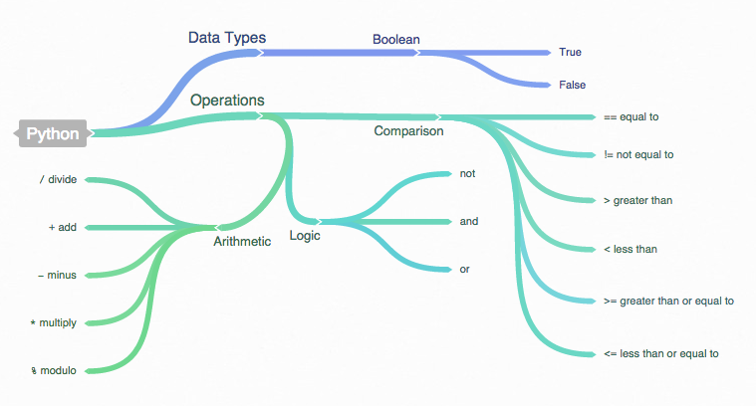
Booleans
Your current mind map

Slide 29
Data types
1
4
BOOLEANS
STRINGS
2
5
3
6

Slide 30
Strings
A string is just a series of characters. Strings can be created with single- or double-quotes: ' or ", like so:
"This is a string."
'This is also a string.'
You can use the addition operator + to concatenate (join together) strings:
"This is " + "a string."
You can also substitute values into strings with the format() method:
"{0} in Big {1}".format(“Master", “Data")
You can treat strings like a list of characters, if you want. This selects the first character in the sentence (sentences are 0-indexed):
“Data science"[0]

Slide 31
Data types
1
4
BOOLEANS
STRINGS
2
5
3
INTEGERS AND FLOATS
6

Slide 32
Numbers: Integers and floats
Integers are whole numbers: 0, 1, 2, 3, ... 100 ... and so on.
Floats or floating-point numbers have a decimal in them: 1.0, 2.25, 150.2 ... and so on.
Other numeric data type such as complex exists, but int and float will be the ones you most often use.
You can add (or multiply, divide, etc.) different types of numbers together, but you will only get one type returned to you.

Slide 33
Data types
1
LISTS
4
BOOLEANS
STRINGS
2
5
3
INTEGERS AND FLOATS
6

Slide 34
Lists
A list is just a sequence of stuff, usually numbers.
Lists are important because they are so flexible:
li = [] # An empty list!
other_li = [1, 2, 3] # A prefilled list!
li.append(1)
li.append(5)
li.append(3)
li # which result do you see?
li.pop()
li # which result do you see?
li[0] # which result do you see?

Slide 35
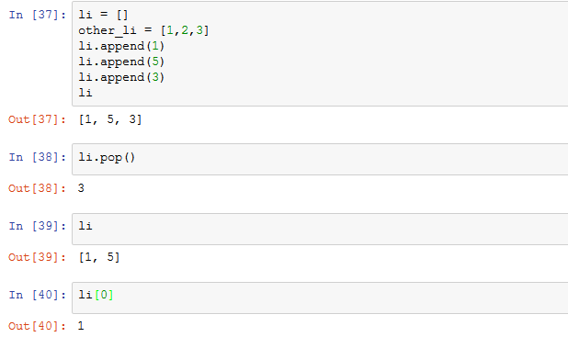
Lists

Slide 36
Lists
0
1
2
3
4
li = [1, 2, 4, 3, 5]
# Select a range between index 1 and 3
# It is identical to […) in math
li[1:3] # which result do you see?
# Omit the beginning or end
li[2:] # which result do you see?
li[:3] # which result do you see?
# Select every second entry (i.e. step by 2)
li[::2] # which result do you see?
# Minimum value in the list
min(li) # which result do you see?

Slide 37
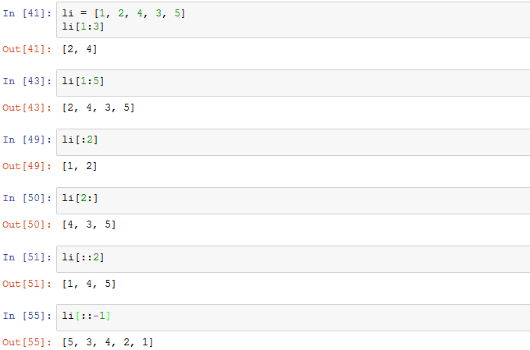
Lists

Slide 38
Data types
1
LISTS
4
BOOLEANS
STRINGS
2
5
SETS
3
INTEGERS AND FLOATS
6

Slide 39
Sets
Sets are like lists that only allow unique entries.
my_set = {1, 2, 2, 3, 4, 5, 6, 7}
my_set # which result do you see?
your_set = {6, 7, 8, 9, 10}
your_set # which result do you see?
# Set intersection - finds the common elements
my_set & your_set # which result do you see?
# Set union - combines the two sets into one
my_set | your_set # which result do you see?
# Existence within a set
1 in my_set # which result do you see?

Slide 40
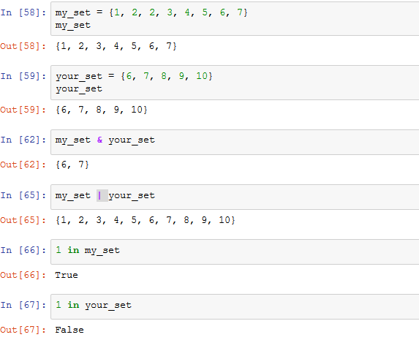
Sets

Slide 41
Data types
1
LISTS
4
BOOLEANS
STRINGS
2
5
SETS
3
INTEGERS AND FLOATS
DICTIONARIES
6

Slide 42
Dictionaries
The dictionary data structure simply associates one value with another, so that k : v, where k is a key and v is the value associated with that key.
So, let's say you make a dictionary like so:
tools = {"IDE": "Integrated Development Environment",
"REPL": "Read–Eval–Print Loop"}
tools
To access just one element in the dictionary, you have to call that dictionary with the name of the key that you want to look up:
tools["REPL"]

Slide 43
Dictionaries
You can do fun things with dictionaries, such as get all of the keys in a dictionary, get all of the values, or check for existence:
tools.keys()
tools.values()
If you lookup a non-existing key, then you get a KeyError. You can avoid this by using the get() method:
tools["TE"]
Traceback (most recent call last):
File "<stdin>", line 1, in <module>
KeyError: 'TE'
Returns None, which is suppressed from display
tools.get("TE")
But we can explicitly print it:
print(tools.get("TE"))

Slide 44
Contents
Python code writing
Data types
Today’s objective
Algorithmic thinking
How to perform a basic analysis of the data.
How to perform basic manipulations with the data.
File formats
Data handling with Pandas

Slide 45
Algorithmic thinking
The goal of algorithmic thinking consists in developing a step-wise procedure used to find the solution to a problem.

Slide 46
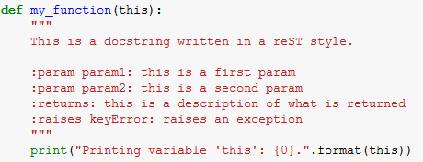
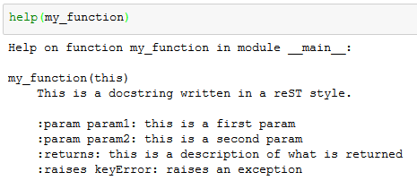
Algorithmic thinking
Often it's helpful to add notes to the code. Python will ignore any line that starts with a # or lines between three single or double quotation marks:
"""
This is text is ignored by Python.
It can be used as a multi-line comment.
"""
# This text is also ignored.

Slide 47
Algorithmic thinking
In order to implement the data processing procedure, we often use IF…ELIF…ELSE statement:
a=10
b=10
if b>a:
print("b ({0}) is greater than a ({1})".format(a,b))
elif a==b:
print("b ({0}) is equal to a ({1})".format(a,b))
else:
print("b ({0}) is smaller than a ({1})".format(a,b))

Slide 48
Algorithmic thinking
Let’s implement a virtual Data Science Project.
Imagine that you acquired the historical data of average traffic intensity per weekdays for the years 2013-2017 for some city.
traffic_data = {
"2013" : [2800,2900,2950,2890,3050,3030,3000],
"2014" : [2700,2915,2950,2880,3020,3030,3020],
"2015" : [2750,2910,2955,2820,3030,3080,3010],
"2016" : [2920,2950,2960,2840,3100,3100,3050],
"2017" : [2930,2940,2970,2900,3150,3300,3080]
}
Your task is to develop the code that selects the data sub-set of 2016 and finds the minimum value of a traffic intensity. If this value is greater than 2000, then you should “store” the result on the hard drive. Otherwise, you should output a message saying that the data is not saved.

Slide 49
Algorithmic thinking
Create an empty repository “BTS_DataScienceFoundations” in your GitHub profile.
echo "# test" >> README.md
git init
git add README.md
git commit -m "first commit"
git remote add origin https://github.com/yourprofile/BTS_DataScienceFoundations.git
git push -u origin master
If you do not have Git installed and configured, you can quickly download and use Github Desktop (Windows and macOS supported). However, it is a good approach to use Git on the command line.
https://desktop.github.com/

Slide 50
Algorithmic thinking
Clone the Git repository to get an initial code:
https://github.com/LianaNapalkova/BTS_MasterInBigData.git
Once you downloaded the repository to your local file system, go to the folder “BTS_MasterInBigData/Session_1
Copy the folder “Session_1” into your local folder “DataScienceFoundations”.

Slide 51
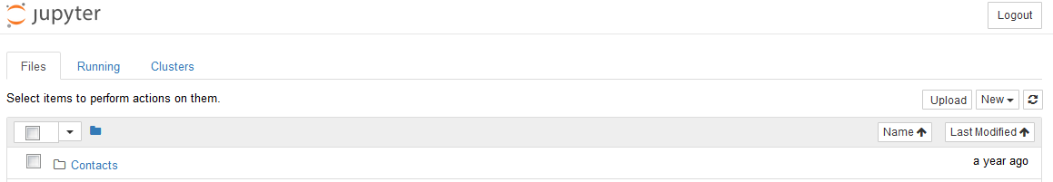
Algorithmic thinking
In the folder “Session_1” you will see a file called:
bts_data_science_foundations_session_1_1.ipynb
Import this file into Jupyter Notebook using the “Upload” button.
Open the imported script and start doing a task.
Your final script should be pushed to your GitHub repository “DataScienceFoundations”.
The button used to upload scripts into Jupyter Notebook

Slide 52
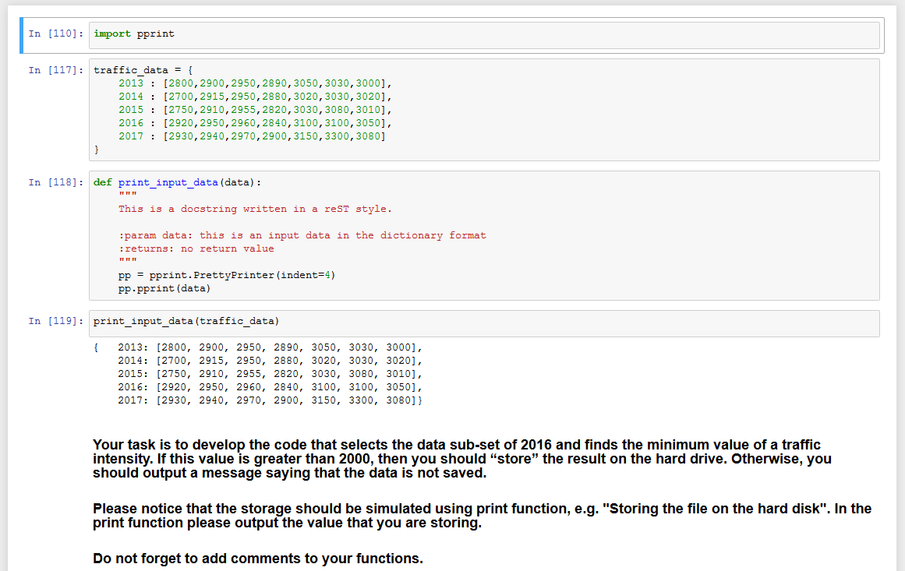
Algorithmic thinking
Please commit your final script to your Git

Slide 53
Algorithmic thinking
This Python script can be thought of as an "algorithm" for a very simple data processing.
Importantly, note that the steps have a chronology to them: you must find a minimum value before checking that it’s greater than 2000, and so on.
In the same manner, algorithms in coding have a chronology to them: an algorithm takes data as inputs, you do some cleaning and processing of the data, and you produce an output.
If you do things in the wrong order, it won't work.

Slide 54
Contents
Python code writing
Data types
Today’s objective
Algorithmic thinking
How to perform a basic analysis of the data.
How to perform basic manipulations with the data.
File formats
Data handling with Pandas

Slide 55
Basic data formats
CSV
JSON
TXT

Slide 56
File formats
Comma-separated values (CSV)
We've been working with variables in Python, but as data scientists, we often have data that we need to import into our program and work with it.
These files are often simple text files, usually with the values separated by a comma or a tab. Comma-separated files are called CSVs and tab-separated files are called TSVs.
Sometimes "CSV" is a misnomer, because text values can be separated by anything, including a pipe (|), a semi-colon (;), or even just a space.

Slide 57
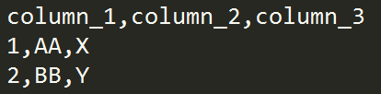
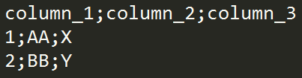
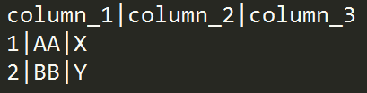
File formats
Comma-separated values (CSV)

Slide 58
File formats
TXT
It’s possible to save the same content as we’ve seen in previous slide as TXT file or using any other extension.
Also, a plain text can be saved in TXT file format.

Slide 59

File formats
JSON

Slide 60
File formats
JSON
{
"name": "Bruno",
"employed": true,
"personal_data": {
"country": "rect",
"age": 35
}
}

Slide 61
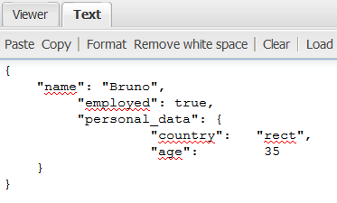
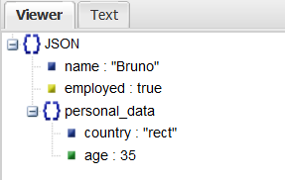
File formats
JSON
Online JSON viewer:
http://jsonviewer.stack.hu

Slide 62
Contents
Python code writing
Data types
Today’s objective
Algorithmic thinking
How to perform a basic analysis of the data.
How to perform basic manipulations with the data.
File formats
Data handling with Pandas

Slide 63
Data Handling with Pandas
Working with data can be a messy business.
To help simplify things, we have a great package called pandas.
This package is written specifically for data analysis and includes a data structure known as a DataFrame. This is a two-dimensional representation of data much like a spreadsheet.
While pandas doesn't normally come with Python, Anaconda has included it by default. To import pandas, you'll need to import the module:
import pandas as pd
As you can see, we give the package an alias, in this case pd.

Slide 64
Data Handling with Pandas
More information about pandas can be found here:
https://pandas.pydata.org/pandas-docs/stable/generated/pandas.read_csv.html

Slide 65
Data Handling with Pandas
Go to the folder “BTS_MasterInDataScience/Session_1/file_formats”.
You have 4 files in this folder.
Load the data from the CSV file “simplefile.csv”:
import pandas as pd
df = pd.read_csv("pathtocsvfile/simplefile.csv")
Pandas will convert all the data into a DataFrame, with column headers based on the header row and row numbers.
You can see the first 5 rows using head():
df.head()

Slide 66
Data Handling with Pandas
To change column names, use:
import pandas as pd
df = pd.read_csv("pathtocsvfile/simplefile.csv",
names=["Name","Age","Country"])
Pandas will convert all the data into a DataFrame, with column headers based on the header row and row numbers.
You can reference a column by the column name like this:
df["Name"]
To get the dimensions of the DataFrame, use this command:
df.shape

Slide 67
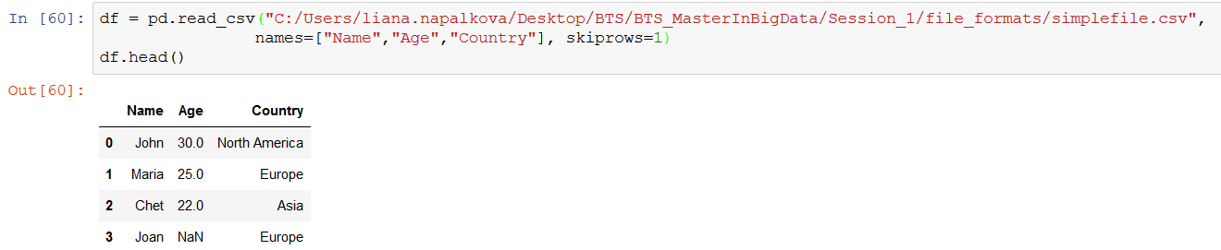
Data Handling with Pandas
As you may see, the original header row was not deleted from the DataFrame. To skip it, you can use:
import pandas as pd
df = pd.read_csv("pathtocsvfile/simplefile.csv",
names=["Name","Age","Country"],
skiprows=1)
Check the content of your new DataFrame:
df.head()

Slide 68
Data Handling with Pandas
Get unique values of the column “Country” in order to see all possible origins of persons in our DataFrame:
df["Country"].unique()
Find the minimum value of the column “Age”:
df["Age"].min()
How can we output the name of the person who has the minimum age?
df[["Name","Age"]].min()

Slide 69
Data Handling with Pandas
Get unique values of the column “Country” in order to see all possible origins of persons in our DataFrame:
df["Country"].unique()
Find the minimum value of the column “Age”:
df["Age"].min()
How can we output the name of the person who has the minimum age?
df[["Name","Age"]].min()
Find the average age:
df["Age"].mean()

Slide 70
Data Handling with Pandas
Check how many “NaN” values are in each column:
df.isnull().sum()
You have probably noticed that some rows contain “NaN” values. It means that no value is defined. Often such values should be substituted by other meaningful values:
df["Age"] = df["Age"].fillna(30)
In other cases you may want to delete “NaN” values. It depends on a concrete context:
df.dropna(subset = ['Age'])

Slide 71
Data Handling with Pandas
Create a new column “Birthyear” applying the formula
CURRENT_YEAR - AGE:
import datetime
year = datetime.datetime.now().year
df["Birthyear"] = df.apply(lambda row: year-row["Age"], axis=1)
More information about the function “apply”:
https://pandas.pydata.org/pandas-docs/stable/generated/pandas.DataFrame.apply.html

Slide 72
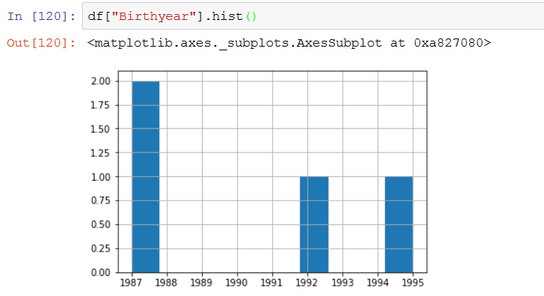
Data Handling with Pandas
Check the distribution of possible values of the column “Birthyear”:
import matplotlib.pyplot as plt
df["Birthyear"].hist()

Slide 73
Data Handling with Pandas
Let’s select only those persons who live in Europe (Boolean indexing).
Compare these two expressions:
df.loc[:,"Country"]=="Europe"
and
df.loc[df.loc[:,"Country"]=="Europe"]

Slide 74
Data Handling with Pandas
Practicing skills
Create a new script in Jupyter Notebook named “data_handling”.
Load the data from the file “rural_population_data.csv” into pandas DataFrame.
Do the following tasks with the data:
Find all unique values of the column “Continent”
Calculate a grow rate based on this formula:
Growrate = (Population2100 - Population2000) / Population2000
Create a histogram of “Growrate”.
Check the existence of NaN values in the DataFrame.
Find the average population size in the years 2000 and 2010.
Check how many rows have UrbanRuralDesignation equal to “Urban”.
Push your script to your Git repository “DataScienceFoundations”.

Slide 75
Individual assignment
Objective: Mastering skills
Recommended data set: https://www.kaggle.com/c/titanic/data
(you should register in Kaggle)
Restriction: The data must be in CSV format
Discover the data set trying to retrieve as much knowledge as you can from your data.
Define 20 basic questions about your data and answer them using the tools that we learned today.
Put your questions into the comments (Cell type: Markdown).
Export your *.ipynb notebook and push it to your repository “DataScienceFoundations”

Slide 76


